Slide 1

Shebin Sam

Slide 2
Religious Distribution
Topic : Religious Distribution
Team :Shebin Sam URK22CS7035
Kmail : shebinsam22@karunya.edu.in
Github Repo:
https://github.com/shebin-sam/Economic-Growth-DS-Hackathon

Slide 3
TABLE OF CONTENTS
Problem Statement And Mapping With UN SDG
Solution Found And Dataset Used
Data Analysis And Model Building
Insights Gained And References Used

Slide 4
PROBLEM STATEMENT
Find the Religious distribution in Jammu and Kashmir By Gender

Slide 5
SOLUTION
Brief about the solution found
How it will improve the current situation
Comparison with existing models

Slide 6
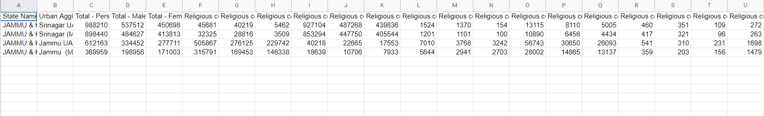
DATASET USED
Data Set (Provided)

Slide 7
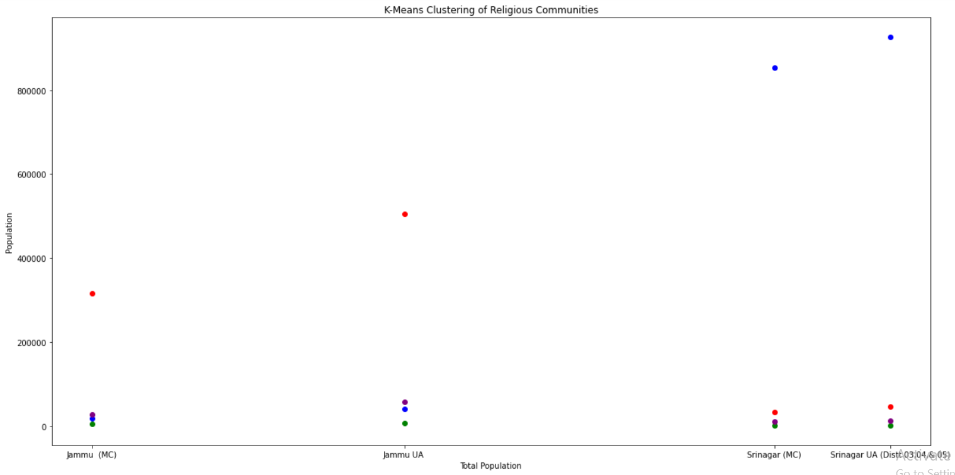
DATA VISUALIZATION

Slide 8
MODEL BUILDING
Division Of Dataset
Train : 75
Test : 25
Tools:
Pandas
Numpy
Scipy
Algorithms:
Linear Regression
The Model Predicts Number Of Females Who May Not Have Stated Their Religious Status

Slide 9
PERFORMANCE METRICS
Mean Squared Error : 1.2183487082958167
Mean Absolute Error : 1.1037883439753369

Slide 10
INSIGHTS GAINED AND REFERENCES USED
References:
Pandas Documentation
Study Material Provided(Colab Notebooks)

